Slide 1




Slide 2

READING SKILLS 1.1
TYPES OF READING

Slide 3

TEST TIME ON WRITING SKILLS 1.1 KEY FOR EFFECTIVE WRITING SKILLS
QR CODE:

Slide 4
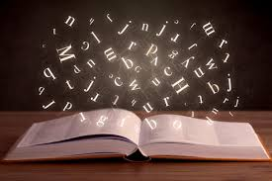
INTRODUCTION
What is Reading?
Notes:
“Reading is to the mind what exercise is to the body,” said English author Joseph Addison.
The comparison couldn’t be more fitting. Just as you need exercise to build your physical strength, you need to read to build your mental muscles.
People read for a variety of reasons—to pass time, to seek answers, or to clear their heads.
Whatever their reasons for reading, it is a great way of exercising the brain and improving your communication skills. Something you really need to grow as a professional. So, what are the different types of reading?
Just as you have simple as well as specialized exercise routines and equipment, you also have different types of reading skills. You can choose the right one depending on your objective.

Slide 5
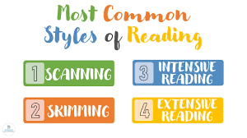
CONCEPTS
Different Types Of Reading
Notes:
It’s important to know the different types of reading skills to make the most of what you are reading. You may reading a novel written by Haruki Murakami or a business report from work. If you’re reading for university, it takes a lot more patience, attention to detail and note-taking. You need to first understand the types of reading there are and then make a case for what you enjoy the most.

Slide 6
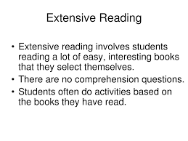
CONCEPTS
Extensive Reading
Notes:
Extensive reading is one of the methods of reading that people use for relaxation and pleasure. Adopt this method when the purpose is to enjoy the reading experience. It places no burden upon the reader and due to its indulgent nature, it is seldom used if the text isn’t enjoyable.
This is one of the methods of reading that occurs naturally. It’s how you’ve read as a child and while growing up.
This method of reading helps you understand words in context and enriches your vocabulary.

Slide 7
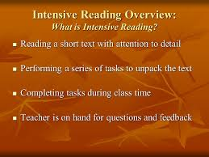
CONCEPTS
Intensive Reading
Notes:
Among the different types of reading skills, intensive reading is used when you want to read carefully by paying complete attention to understand every word of the text. It is where you would examine and decipher each unfamiliar word or expression.
As the term states, intensive means in-depth. This reading method is especially used when reading academic texts, where the goal is to prepare for an exam or to publish a report. This method helps retain information for much longer periods.

Slide 8
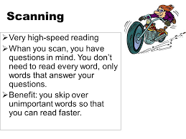
CONCEPTS
Scanning
Notes:
Imagine if you went to the Louvre museum only to see the Mona Lisa. You’d quickly walk through all the corridors and rooms merely glancing at the walls until you found it. Scanning is quite similar to that.
It is one of those kinds of reading where you read to search for a particular piece of information. Your eyes quickly skim over the sentences until you find it.
You can use this method when you don’t need to go deep into the text and read every word carefully. Scanning involves rapid reading and is often used by researchers and for writing reviews.

Slide 9
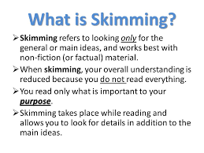
CONCEPTS
Skimming
Notes:
Through this method, you try to understand the text in short. Though one saves a lot of time through this method, one will gain only a shallow understanding of the text.
Skimming is a great way to get a broad idea of the topic being discussed. This method is generally used to judge whether the information is useful or not.
A good example of this is picking up a magazine and flipping through the pages. You take in only the headings or the pictures to get a broad idea of what the magazine covers.

Slide 10
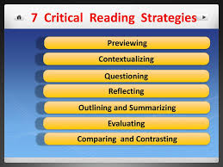
CONCEPTS
Critical Reading
Notes:
Among the different types of reading strategies, critical reading has a special place. Here, the facts and information are tested for accuracy. You take a look at the ideas mentioned and analyze them until you reach a conclusion.
You would have to apply your critical faculties when using this method. Critical reading is often used when reading the news on social media, watching controversial advertisements, or reading periodicals.

Slide 11

CONCEPTS
There are a variety of preparatory and supportive reading skills

Slide 12
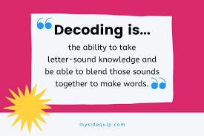
CONCEPTS
Decoding
Notes:
To be a good reader, you have to be able to decode words. Decoding is the ability to apply your knowledge of letter-sound relationships and letter patterns and correctly pronounce written words.

Slide 13
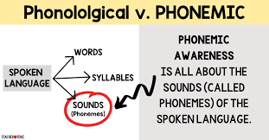
CONCEPTS
Phonological and phonemic awareness
Notes:
Decoding relies heavily on phonological awareness, which refers to an individual’s awareness of the sound structure of language. A listening skill, phonological awareness is the ability to distinguish between speech units such as rhymes, syllables in words, and individual phonemes in syllables.
Phonological awareness is often confused with phonics. The latter requires students to know and match letters or letter patterns with sounds, learn spelling rules, and use this information to decode (read) and encode (write) words. Phonological awareness relates only to speech sounds, not alphabet letters or sound-spellings.
Phonemic awareness is a subset of phonological awareness that focuses on recognizing and manipulating phonemes, the smallest sound units. Two crucial phonemic awareness skills are segmenting and blending.

Slide 14
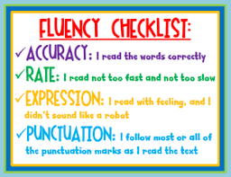
CONCEPTS
Reading fluency
Notes:
Sounding out or decoding every word can take much effort. Fluency, defined as “speed, accuracy, and proper expression,” gained prominence when it was included as one of five essential reading skills in a national-level research synthesis on reading instruction.
To read fluently, readers need effective word recognition skills. Word recognition is the ability to recognize whole words instantly by sight without sounding them out.
Reading fluency speeds up the rate at which they can read and understand text. Reading fluency is also important when kids encounter irregular words, like one and the, which cannot be sounded out.
When kids can read smoothly without making too many errors, they are “fluent readers.”

Slide 15




THANK YOU
+91 78150 95095
codemithra@ethnus.com
www.codemithra.com

